Slide 1
Preparing for TFTR D-T Experiments
R.J. Hawryluk May 23, 2014

Slide 2
Dwight Eisenhower
“In preparing for battle I have always found that plans are useless, but planning is indispensable.”
Garry Kasparov
"It is better to have a bad plan than no plan."

Slide 3
TFTR D-T Plan Was Revised Regularly to Reflect Scientific, Technical and Regulatory Changes 1987, 1988, 1991, 1993
Introduction
Physics
Operational Scenarios
Machine Configuration and Modifications
Radiation Analysis
Tritium, Tritium Neutral Beams
Decommissioning, Mothballing
Training, Qualification and Certification
Radiation Safety
Reliability and Quality Assurance
Schedule
Conclusion

Slide 4
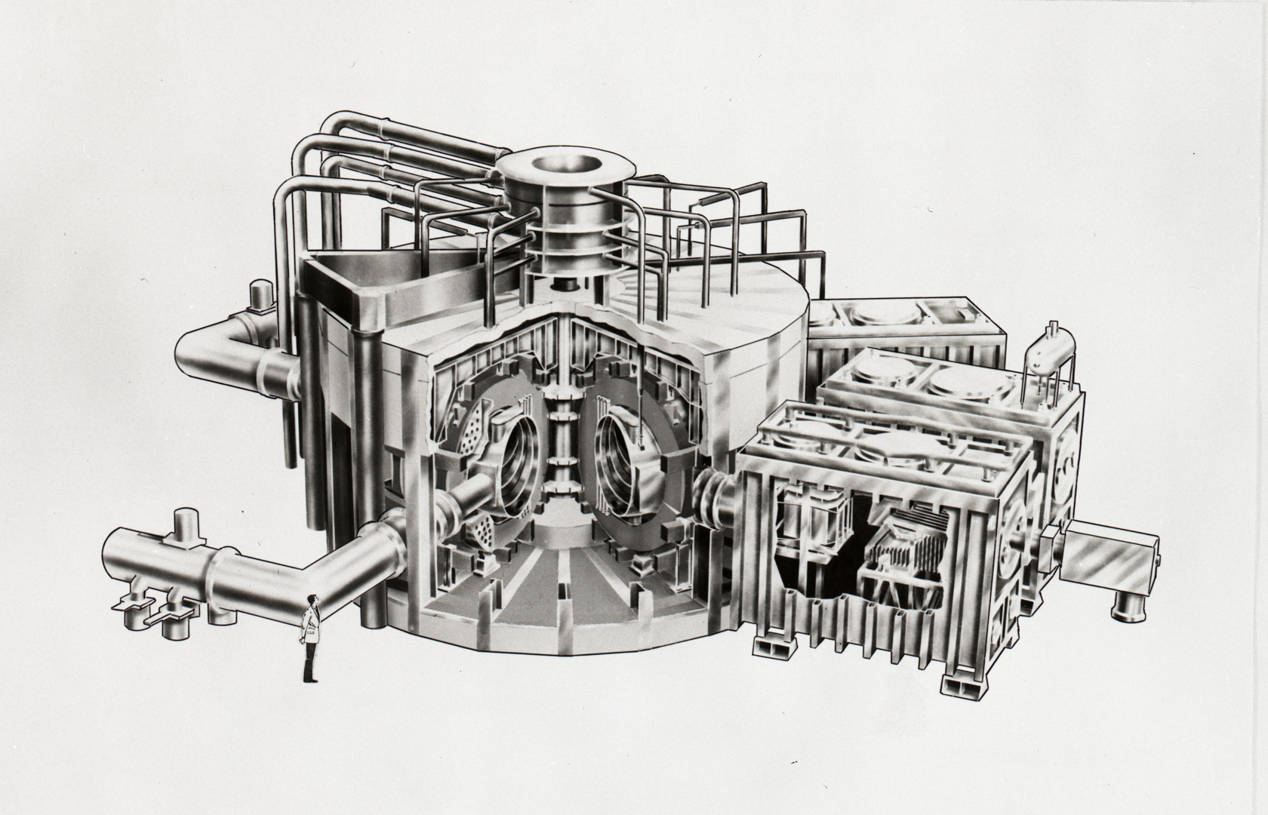
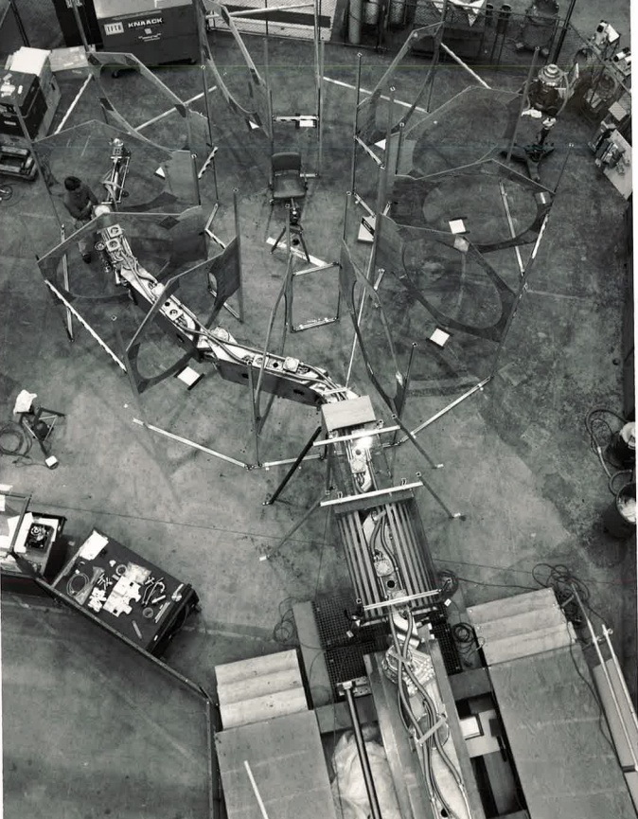
Machine Configuration
Machine Design:
Adiabatic compression
Bt=5.2 T and Ip= 2.5MA
Three Co and 1 Ctr beamline
Remote maintenance
1988:
Removed ZrAl gettering
Reconfigured NB to balance
Adiabatic compression was abandoned
1991:
Remote manipulator built by Karlsruhe was not installed and lithium blanket module funded by EPRI
1993:
Replaced water cooling for TF with flourinert for reliability
Bt= 5.9 T and Ip = 3. MA during DT campaign

Slide 5
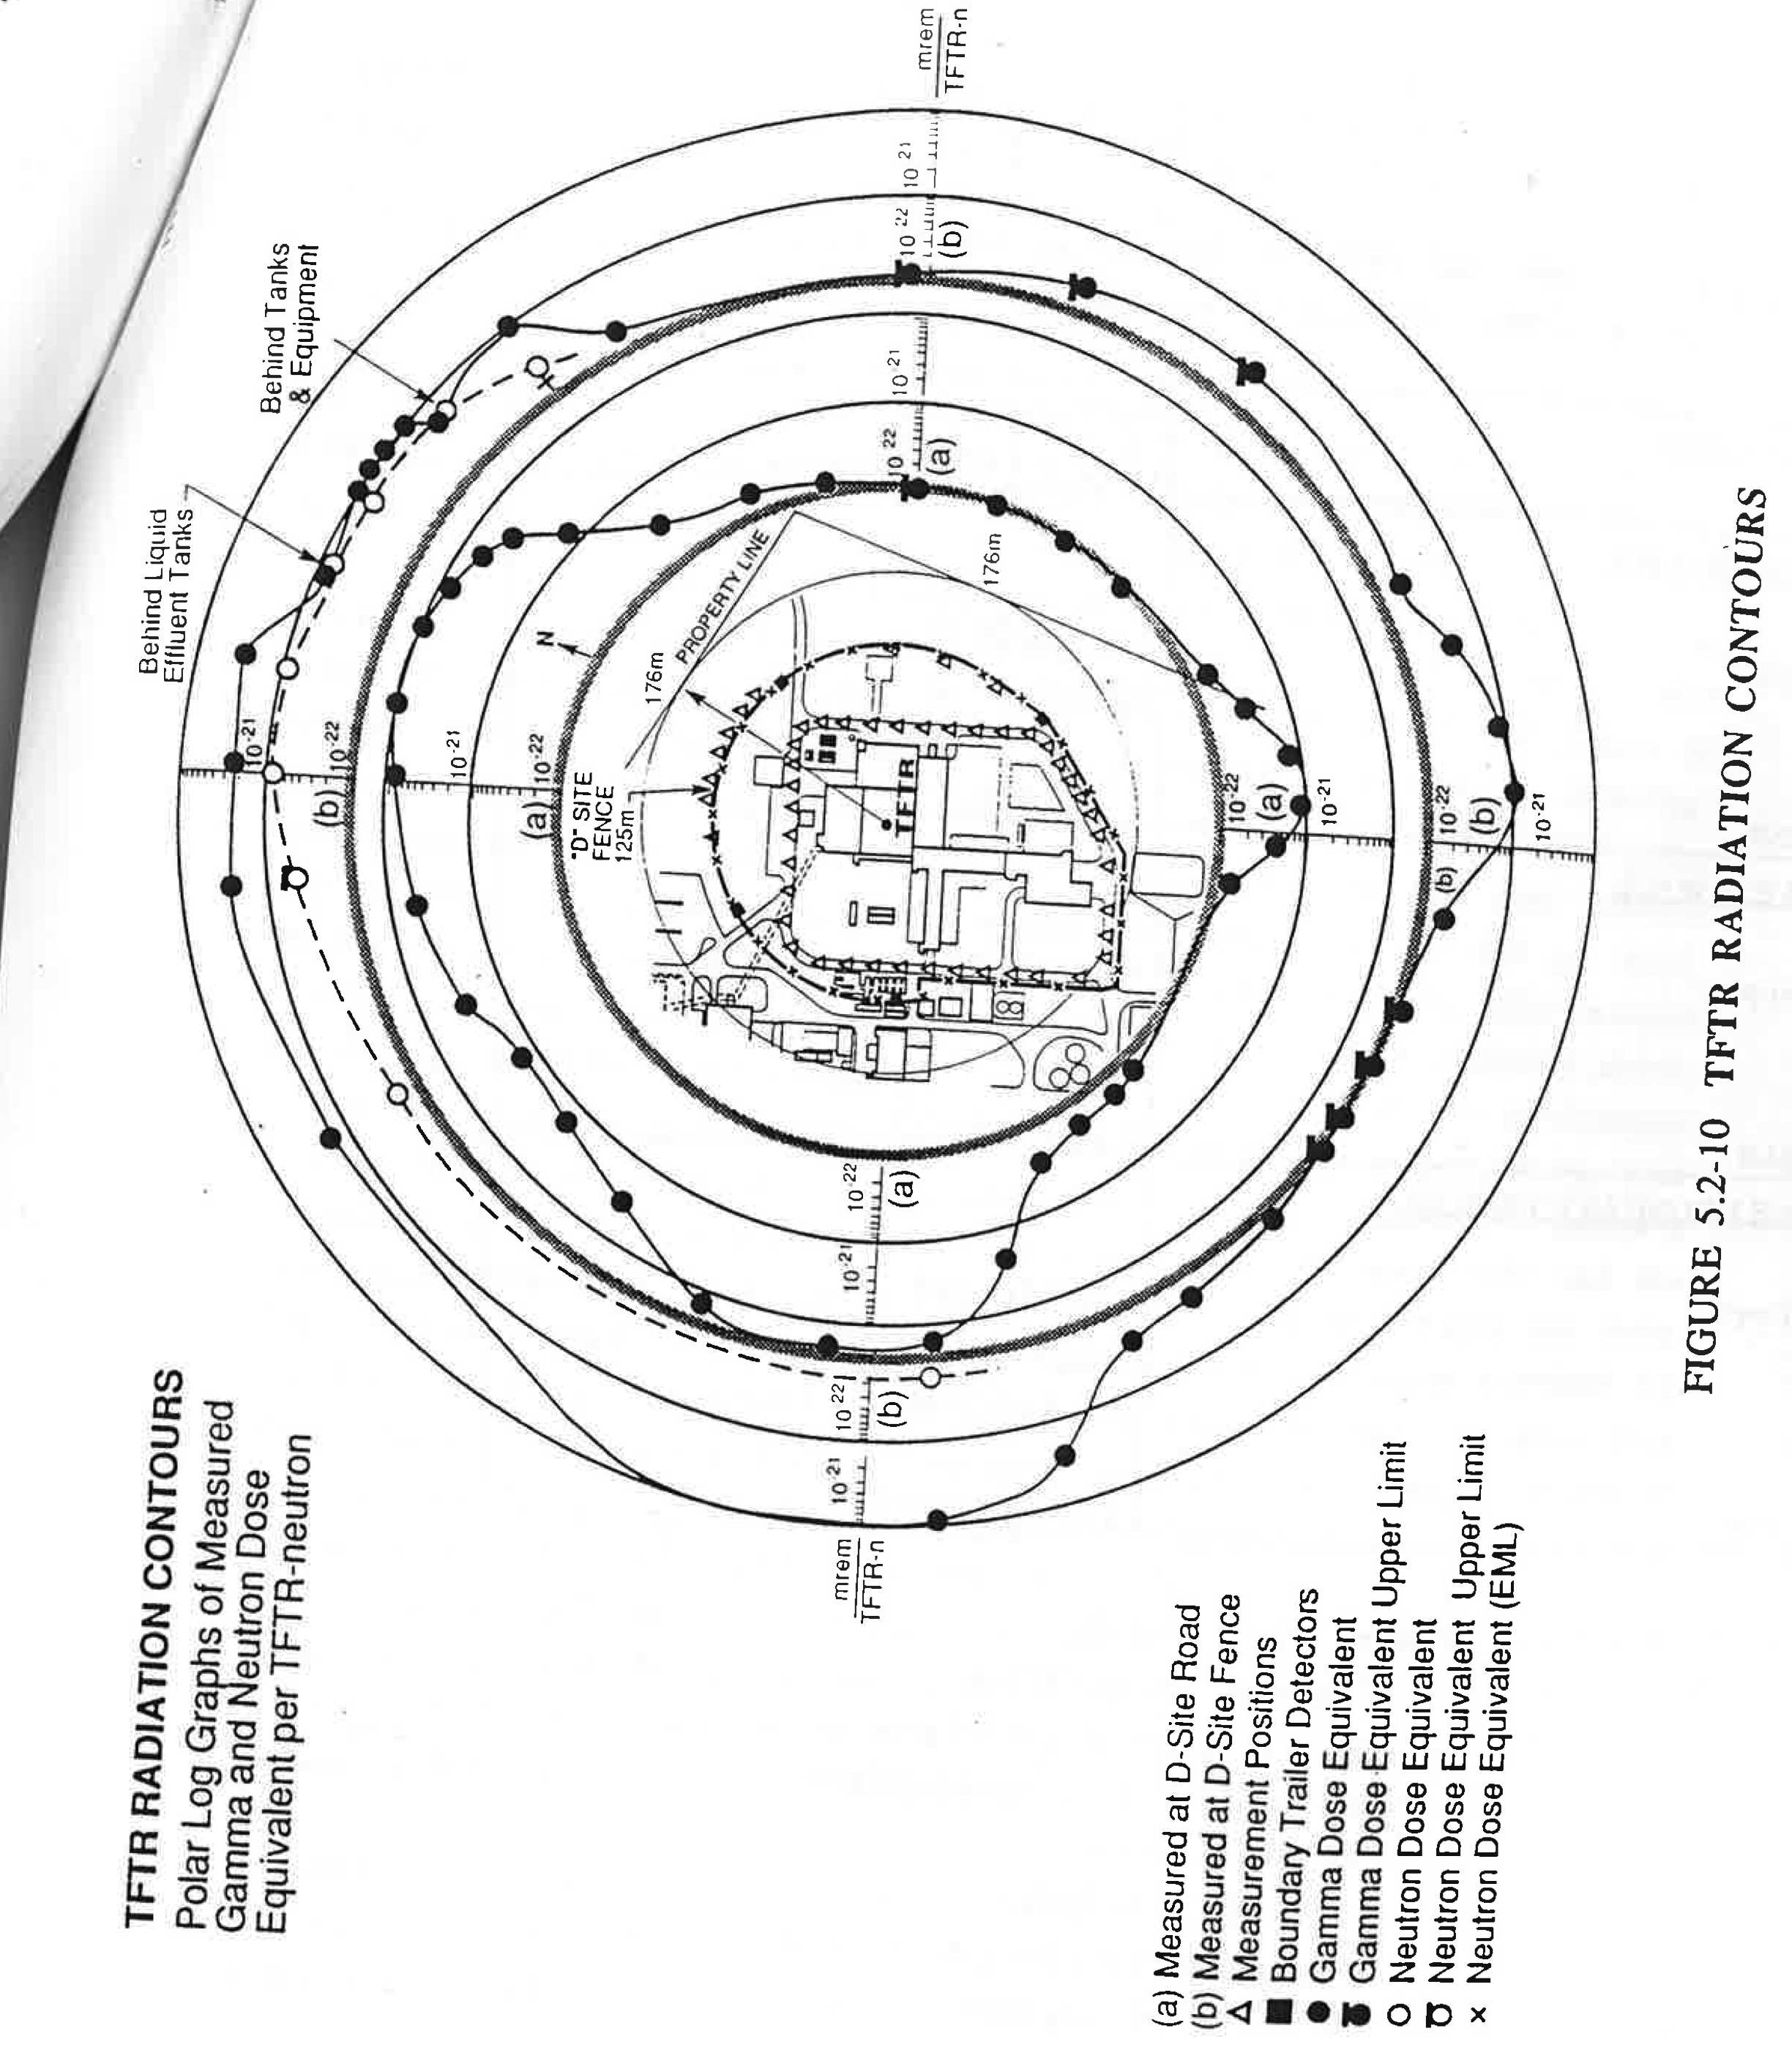
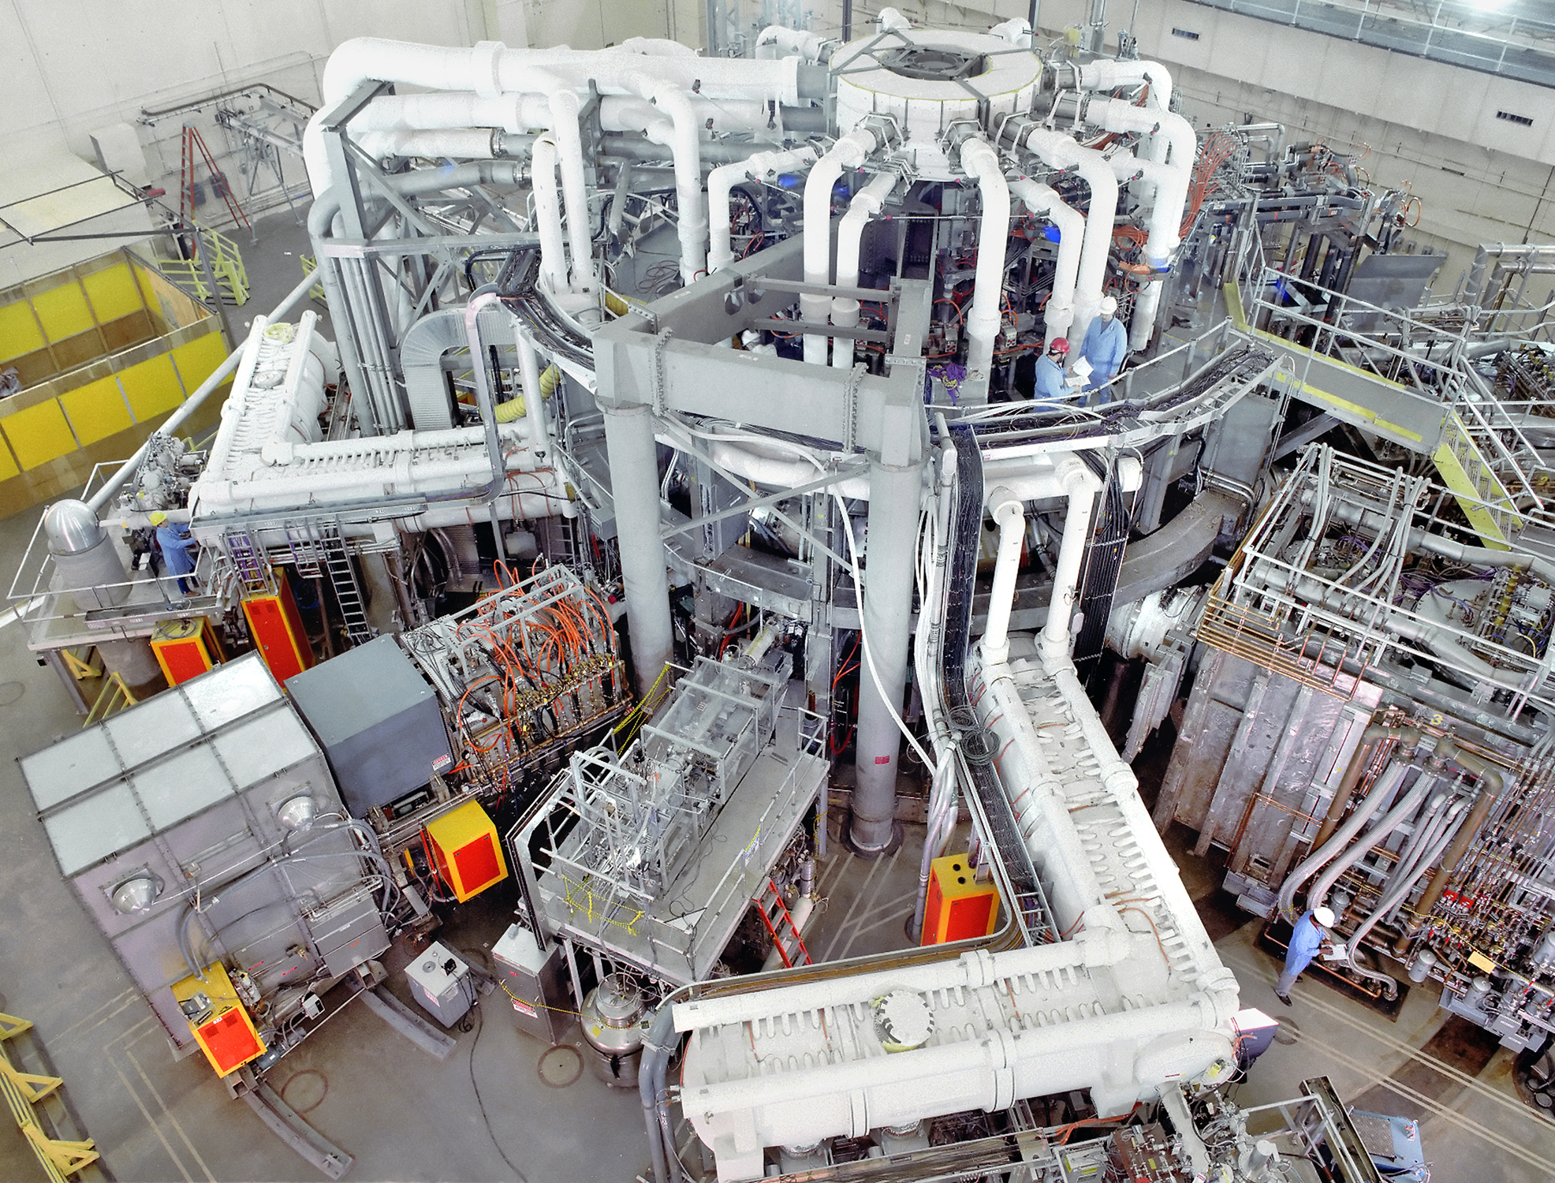
Radiation Shielding and Analysis
Machine Design:
Igloo
1991:
Igloo was omitted based on extensive site boundary measurements in DD and then in DT
Additional shielding on north wall was installed
Detailed study of site specific climatology, along with a more rigorous evaluation of the potential worst case accident, demonstrated that the safety implications of tritium release from such an accident were less than expected (390 mrem instead of 2730 mrem).

Slide 6
Training, Qualification and Certification
Transition from deuterium operation to D-T required large increase in formality and rigor due to TFTR being classified a Category 3 nuclear facility.
Formal training, qualification and certification programs for tritium operators and Chief Operating Engineers
In light of the problems in the Defense facilities and tritium release at BNL increased emphasis was placed on safety and environmental concerns just as we were preparing for D-T
A perfect storm.
The Tiger Teams in 1990 were a wake up call for the expectations for a nuclear facility.
Successfully made the transition and implemented Conduct of Operations requirements.
Despite the increased formality had a record number of PRLs!

Slide 7
Extensive Review of Safety and Environment Analysis
Environmental Reviews:
1975 (FES) worst case accident 1.3kCi HTO
1990-92 (EA) 25 kCi HTO
Extensive review by DOE, NJ Department of Environmental Protection
Two public meetings at PPPL
Finding of No Significant Impact January 1992
Issues identified:
lack of sufficient inventory of tritium shipping containers led to construction of tritium purification system
underestimate of retention in the torus
Final approval in Jan. 1993
Safety Reviews
Preliminary Safety Review 1975 prior to authorization for construction
Final Safety Review (1982) prior to first plasma
Updated Final Safety Review (1993)
Technical Safety Requirements, Unreviewed Safety Question Determination, Operating Parameter Requirements etc.

Slide 8
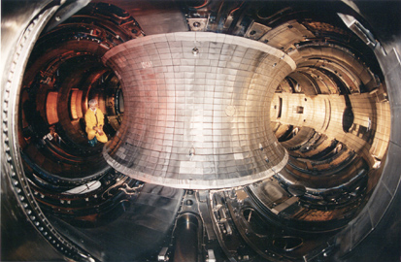
Tritium, Tritium Pellet Injector, Tritium Neutral Beams
Machine Design
Tritium fueling by gas injection
Low on-site tritium inventory of 5g
(2.5g in process)
Retention was not identified
as a significant issue
Deuterium beams
1987/1988
Supershots and modeling identified the need for tritium neutral beams
Very large increase in tritium processing requirements
Most of the tritium went to the neutralizer and not the plasma
Planned on incorporating tritium pellet injection
Recognized that retention in graphite PFCs was a serious constraint

Slide 9
Tritium, Tritium Pellet Injector, Tritium Neutral Beams (Cont.)
1993
Abandoned tritium pellet injection due to budget constraints
Concern identified with availability of UC-609 tritium shipping containers
Backup plan implemented to do on-site tritium processing
Successfully implemented during DT campaign
Very challenging due to low tritium inventory limits
Put in place very stringent tritium accountability measures
Final result:
Operated the tritium systems very successfully and satisfied accountability requirements
Tritium beams were more reliable than deuterium beams
Round-the-clock operation of the tritium systems was done safely and successfully
On-site tritium purification system was operated. First closed cycle reprocessing of Tritium on an operating tokamak.

Slide 10
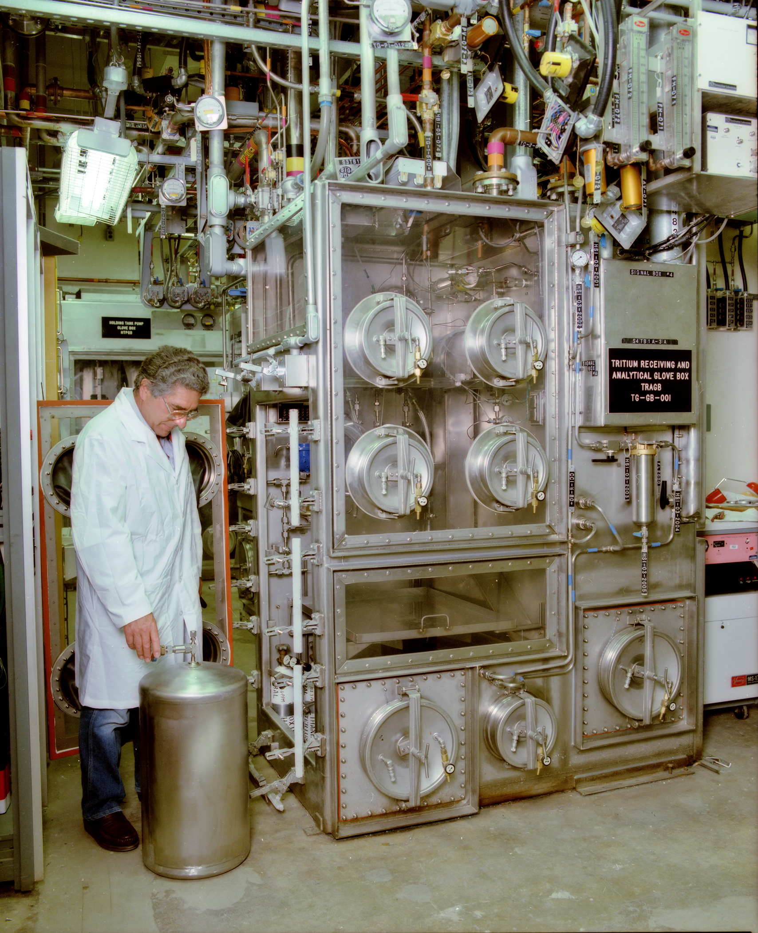
Main Items in the D-T Prep Project
Commissioning of the tritium systems
Operator training and certification
Modifications of vacuum and gas handling systems
HVAC modifications to enable negative pressure
Penetration filling for fire and negative pressure qualification
Seismic qualification
Tritium and radiation monitoring
Flourinert system
Modification and upgrade of diagnostics
Increased shielding
Modifications to vacuum systems
Alpha-particle physics diagnostics
Beam system modification for tritium
In 2014 dollars ~$95M project, >80% done in 2 years
While operating TFTR!

Slide 11
Reliability and Quality Assurance
Can we do the D-T program without breaking vacuum or a major machine failure?
The plan was to operate in D-T for less than a year and then build TPX
Did not have remote maintenance other than long handled tools.
Operated for three years without breaking vacuum.
Surmounted unexpected problems such as repairing a vacuum leak due to energetic particles drilling holes in the vacuum vessel.
Minimized personnel exposure and made the repair hands-on
Removal of the igloo enabled maintenance of the vacuum vessel
Extended operation resulted in qualifying the neutral beam source repair facility for tritium
Flourinert system enabled us to live with the leaks in the TF coils.
In 1996, vented the machine and installed diagnostics and a new IBW antennae.
Demonstrated that we can operate and maintain a DT facility!

Slide 12
TFTR Had an Excellent Tritium Safety Record
10mrem site boundary dose requirement (factor of ten less than legal requirement)
Actual contribution was 0.027-0.078 mrem/yr (0.05 mrem/yr avg) from neutrons and gammas
Tritium releases were below all regulatory requirements
Annual airborne releases of tritium (via stack): range of 62-260 Ci/yr, average was 131 Ci/yr. Limit was 500 Ci/yr.
Annual liquid tritium releases (to sanitary sewer system via TFTR Liquid Effluent Collection Tanks): range of 0.071-0.951 Ci/yr, average was 0.322 Ci/yr. Limit was 1 Ci/yr.
Maximum Annual Individual Effective Dose Equivalent (at Site Boundary): range of 0.21-0.68 mrem/yr, average was 0.40 mrem/yr. Limit was 10 mrem/yr.

Slide 13
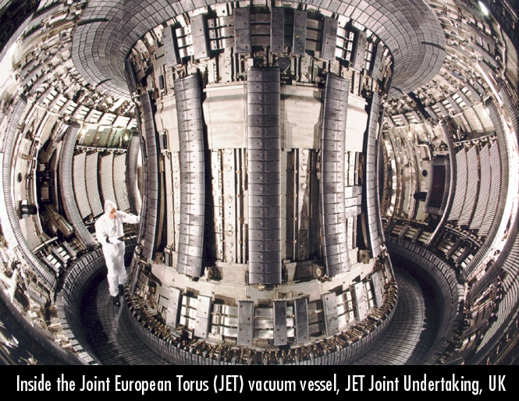
JET and TFTR were Designed to Perform Deuterium-Tritium Experiments and Did!
JET
TFTR
I_{p}(MA) 4.0 2.7
B_{T}(T) 3.6 5.6
P_{DT}(MW) 16.1 10.6
P_{DT}/P_{in}=Q_{DT} 0.64 0.27
Fusion Energy (GJ) 0.68 1.70
Tritium Proc. (g) 99.3 99.

Slide 14
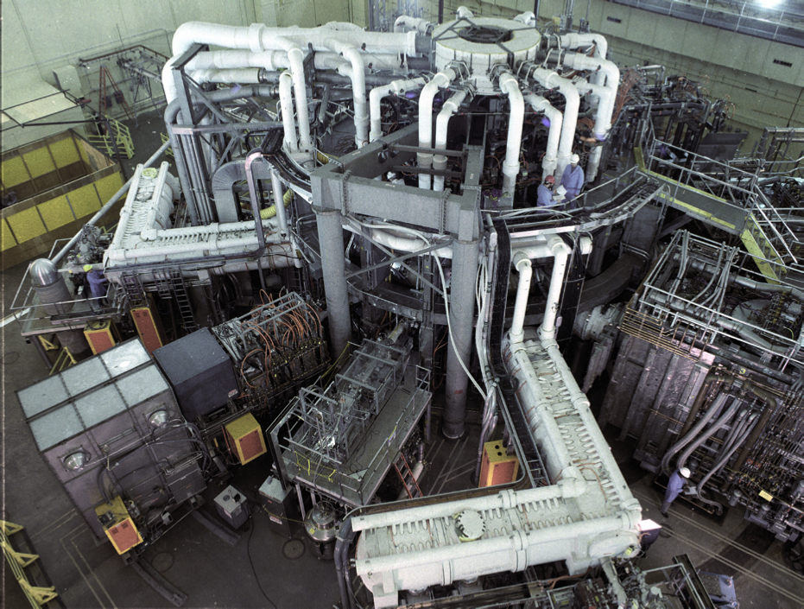
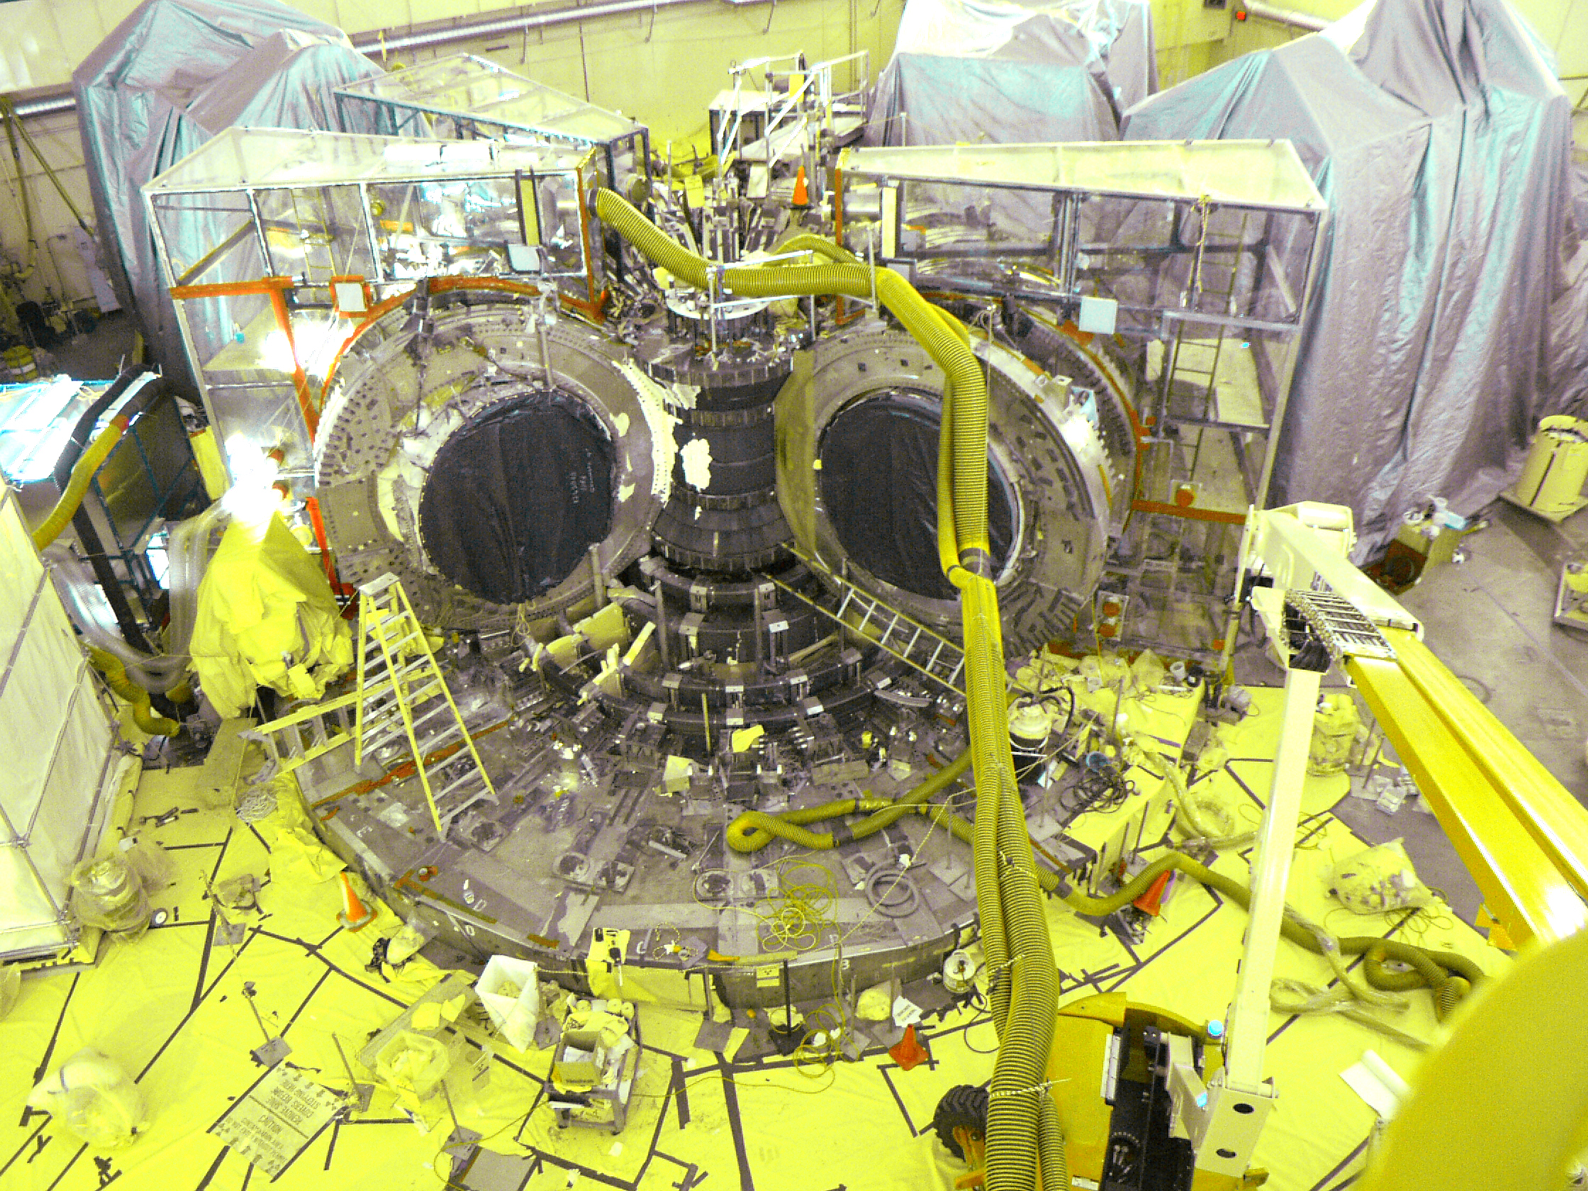
Successful Demonstration of Decommissioning of a Fusion Facility
TFTR
• Developed diamond wire cutting technique to safely disassemble the machine

Slide 15
What Did We Learn?
Safe operation with D-T was demonstrated.
Stakeholder (public and DOE) support is critical.
Demonstrated D&D of a tritium contaminated and neutron activated facility
Need to adapt to changing scientific, technical and regulatory results.
Keep the goal in focus but question your assumptions and act.
Regulatory and safety considerations are paramount.
Affected everything we did.
Demonstrated that it was possible to achieve scientific and technical goals within regulatory constraints.
Scientific productivity and machine reliability improved during the D-T campaign!

